Slide 1
Evaluation of Machine Learning Algorithms for MNIST Dataset
By Mubashir Ahmed CSC-21F-061

Slide 2
Introduction
Objective:
Explore effectiveness of four algorithms in classifying handwritten digits
Algorithms:
Logistic Regression (LR)
K-Nearest Neighbors (KNN)
Random Forest (RF)
Convolutional Neural Networks (CNN)
Evaluation Metrics:
Accuracy
Log Loss
Precision
Recall
F1 Score

Slide 3
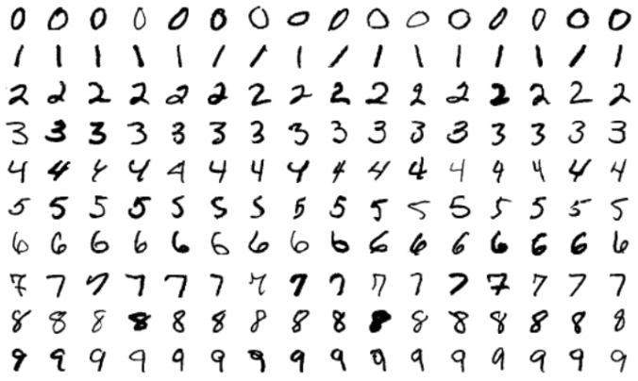
MNIST Dataset
Source: https://www.kaggle.com/datasets/hojjatk/mnist-dataset (NIST)
Composition:
60,000 training images
10,000 test images
Images of handwritten digits (0-9)
Image Details:
Size: 28x28 pixels
Gray levels: 256

Slide 4
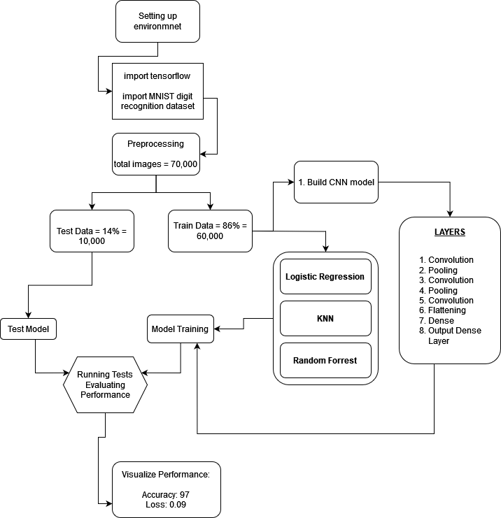
Methodology
Data Collection and Preprocessing
Data Source:
MNIST dataset
60,000 training images
10,000 test images
Preprocessing:
Normalize images to pixel values [0, 1]
Reshape for CNN to 28x28x1 arrays

Slide 5
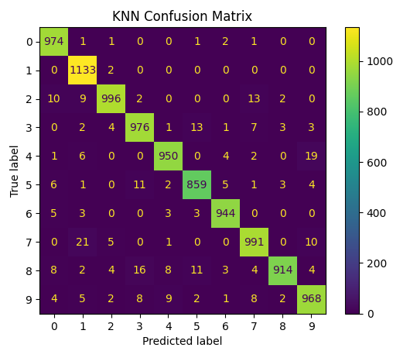
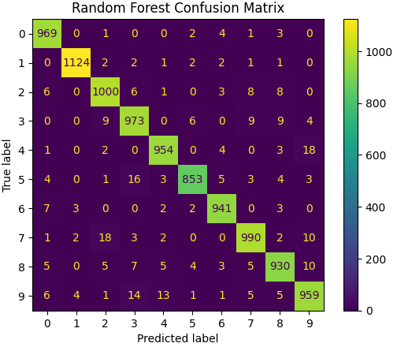
Evaluation

Slide 6
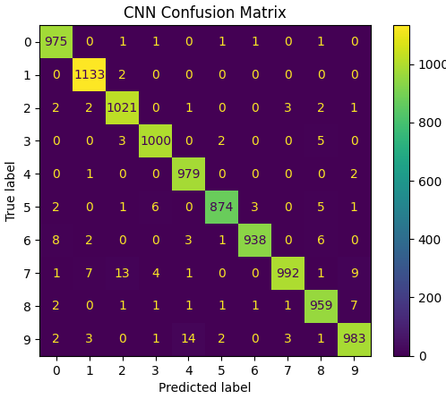
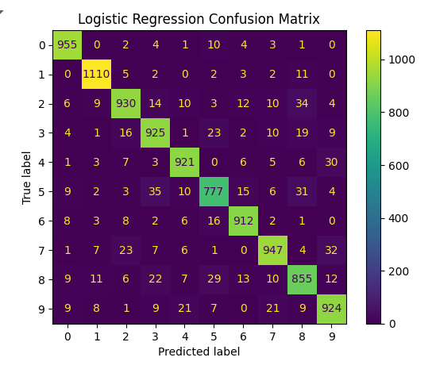
Evaluation (Cont..)

Slide 7
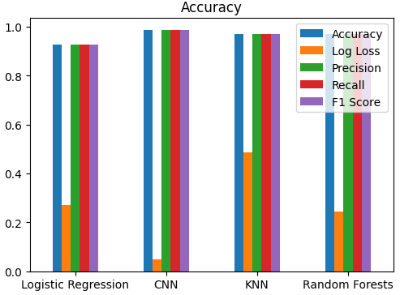
Evaluation (Cont..)

Slide 8
Conclusion
CNNs are most effective for MNIST digit recognition
Potential for further optimization and real-world application scalability

Slide 9
Interpretation:
CNN outperforms with highest accuracy (98.52%) and lowest log loss (0.0524)
RF and KNN show strong performance, slightly behind CNN
LR demonstrates good baseline performance

Slide 10
References:
[AN ENSEMBLE OF SIMPLE CONVOLUTIONAL NEURAL NETWORK MODELS FOR MNIST DIGIT RECOGNITION]
[Assessing Four Neural Networks on Handwritten Digit Recognition Dataset (MNIST)]
MNIST Database
TensorFlow Documentation
Keras Documentation
chat.openai.com
gemini.google.com

